Slide 1

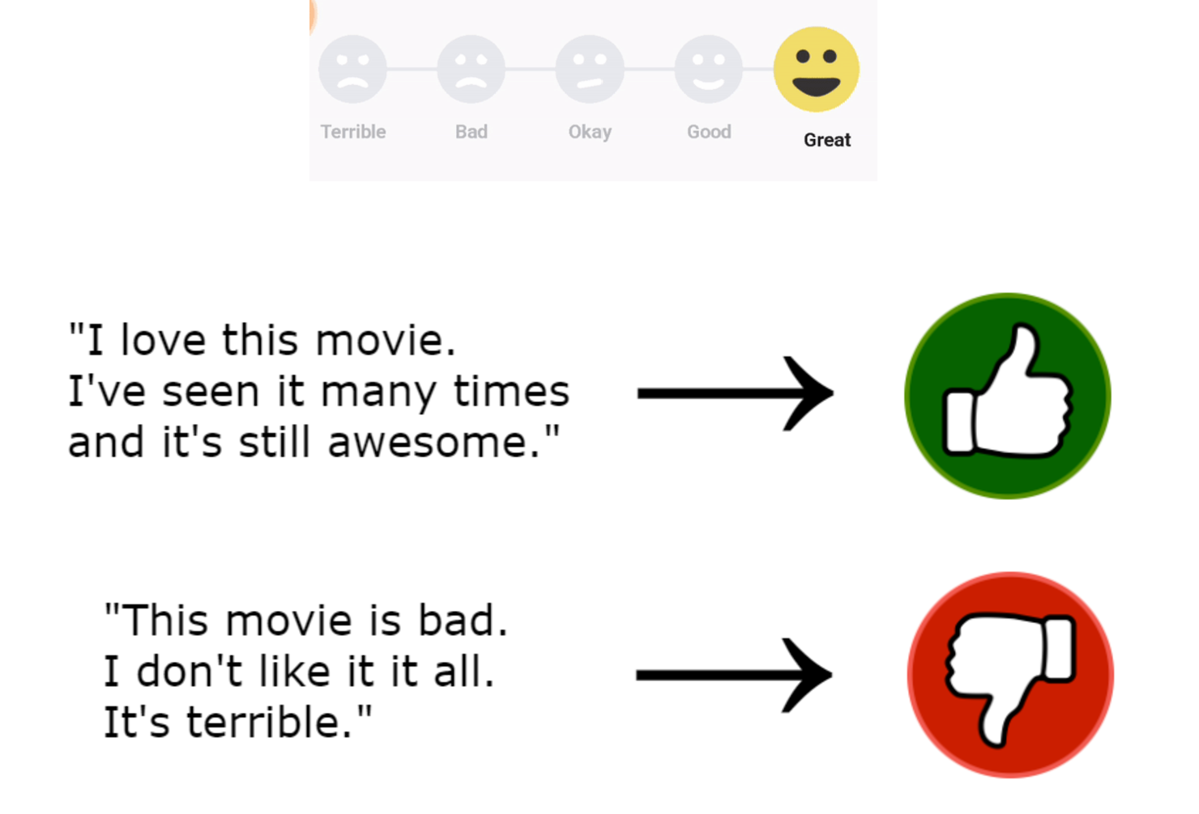
Sentiment Analysis Of Movie Reviews
A Machine Learning(COSC540600224F) Project
Guided By :
Prof. Ajmery Sultana
Submitted By:
Hardiksinh Solanki (249531990)
Dikshaben Patel (249432540)

Slide 2
Outline
INTRODUCTION TO SENTIMENT ANALYSSIS
UNDERSTANDING THE PROBLEM STATEMENT
DATASET DESCRIPTIONS
PROCESS FLOW
UNDERSTANDING PREPROCESSING
MODELS AND EVALUATION
RESULTS AND ANALYSIS
A SHORT DEMO
CONCLUSION

Slide 3
INTRODUCTION TO SENTIMENT ANALYSSIS
What is sentiment analysis?
Sentiment analysis is a Natural Language Processing (NLP) technique used to determine the emotional tone or sentiment expressed in text.
Why is it important in analyzing movie reviews?
Understanding Public Opinion
Improved Decision-Making
Recommendation Systems
Quality Improvement of Movies
Trend Analysis
Box Office Prediction for market
Business Decisions for investments in movie productions

Slide 4
Understanding the Problem Statement
How can we determine whether a movie review is positive or negative based on its text?
Challenges: Processing natural language.
Converting textual data into numerical representations using techniques like Bag of Words (BoW) or TF-IDF.
Text data is unstructured and noisy, with slang, abbreviations, and misspellings (e.g., "gr8 movie!" vs. "great movie!").
Detecting sarcasm or irony is difficult (e.g., "This movie deserves an Oscar... for worst film!").
Phrases like "not bad" need special handling as they imply positivity despite the presence of "not."
Sentiment analysis for movie reviews is both a fascinating and demanding task, requiring robust preprocessing and careful model selection.

Slide 5
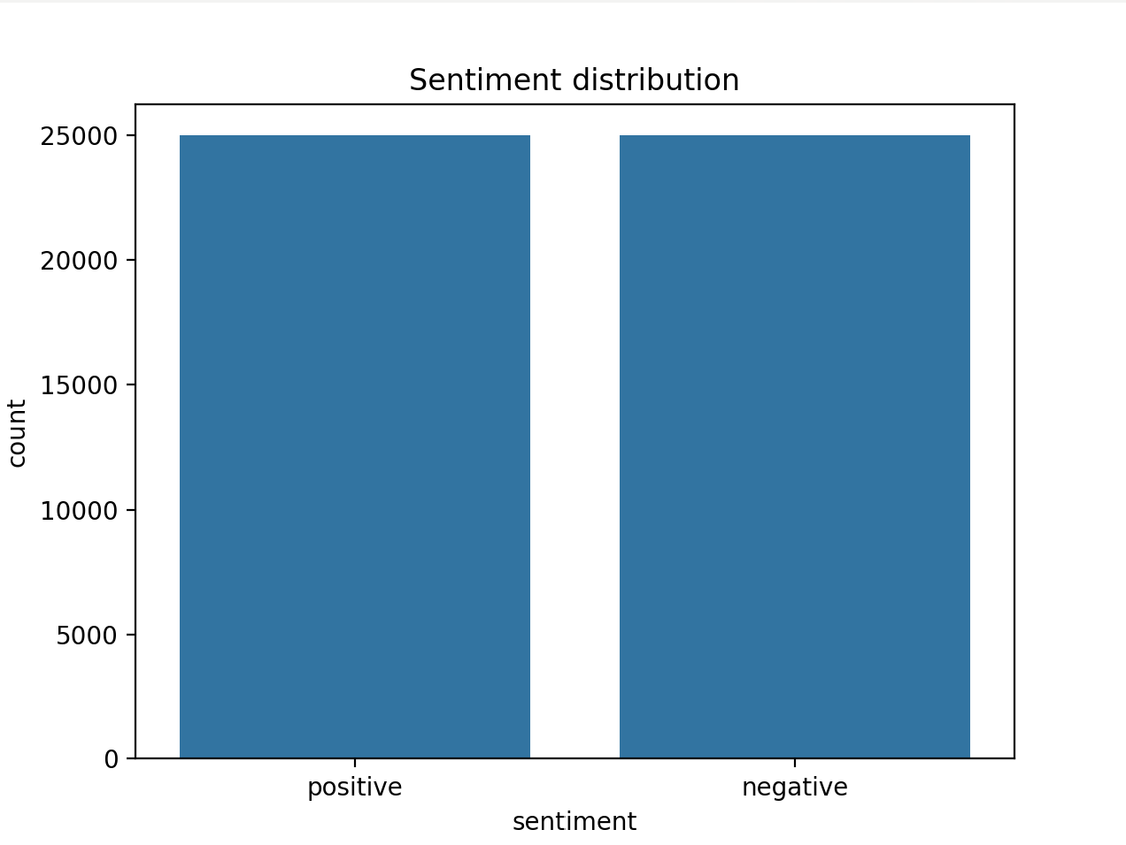
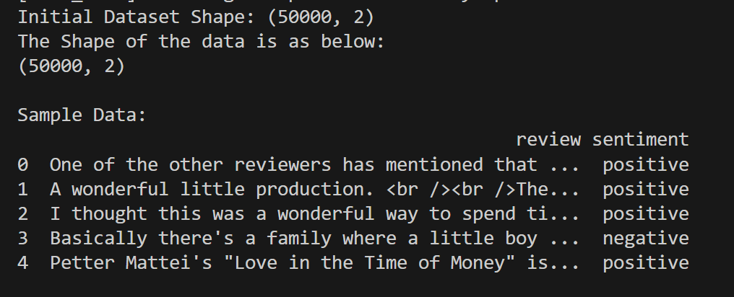
Dataset Description
Dataset Used: IMDB Dataset of 50K Movie Reviews.
Size: 50,000 reviews.
Classes: Positive (1) and Negative (0).
No Missing Values
422 Duplicate Values Removed

Slide 6
Process FLow
Dataset Preparation
Load The Dataset
Text Pre-processing
Cleaning Reviews by removing html tags, stop words and lower case conversion
Feature Extraction
Used Bag-of-Words (BoW) to convert text into numerical features (a matrix of word frequencies) for machine learning.
Model Training
Evaluation
Model Deployment
Stemming to reduce words
Map the sentiment to binary values (1 – positive, 0-negative )
Trained 4 models
Logistic Regression, Naïve Bayes, Linear SVC and Random Forest
Compared Models using metrics: precision, matrix, recall, and F1-score.
Saved best model for predictor application

Slide 7
UNDERSTANDING Data PREPROCESSING
Converted text to Lowercase
Removing HTML tags, punctuation, and special characters.
Removing stop words, non-alphabetic characters and extra spaces.
Stemming the Data.
Before preprocessing: "This movie is AMAZING!! Loved it!"
After preprocessing: "movie amazing loved"
Feature Extraction using Bag of Words
Reviews : “loved movie” , “amazing acting” , “amazing movie acting”
Word Index: loved movie amazing acting
Review 1: 1 1 0 0
Review 2: 0 0 1 1
Review 3: 0 1 1 1
Word Cloud

Slide 8
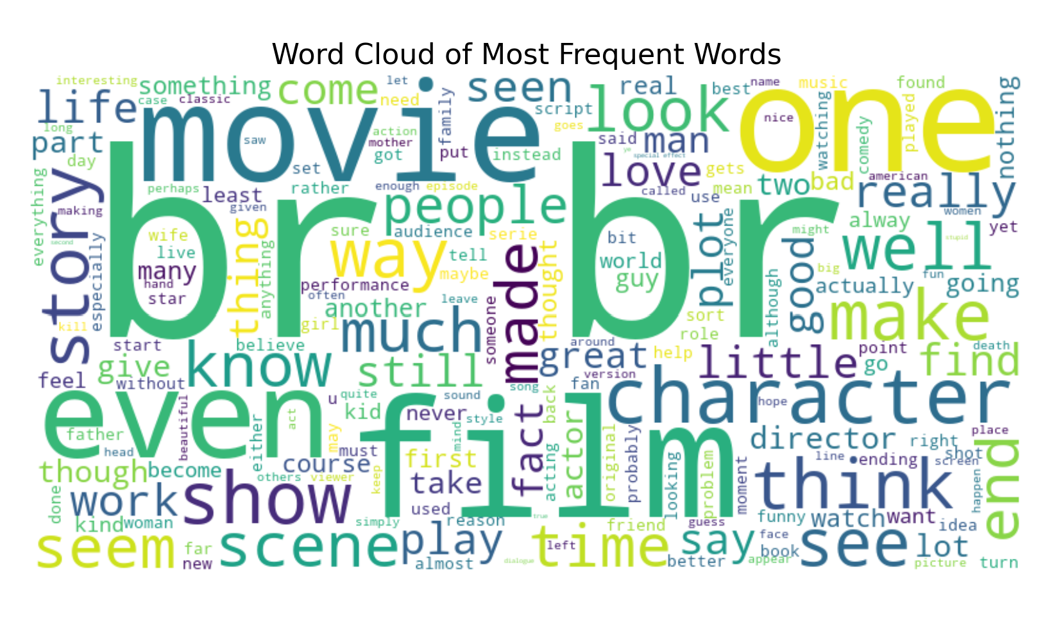
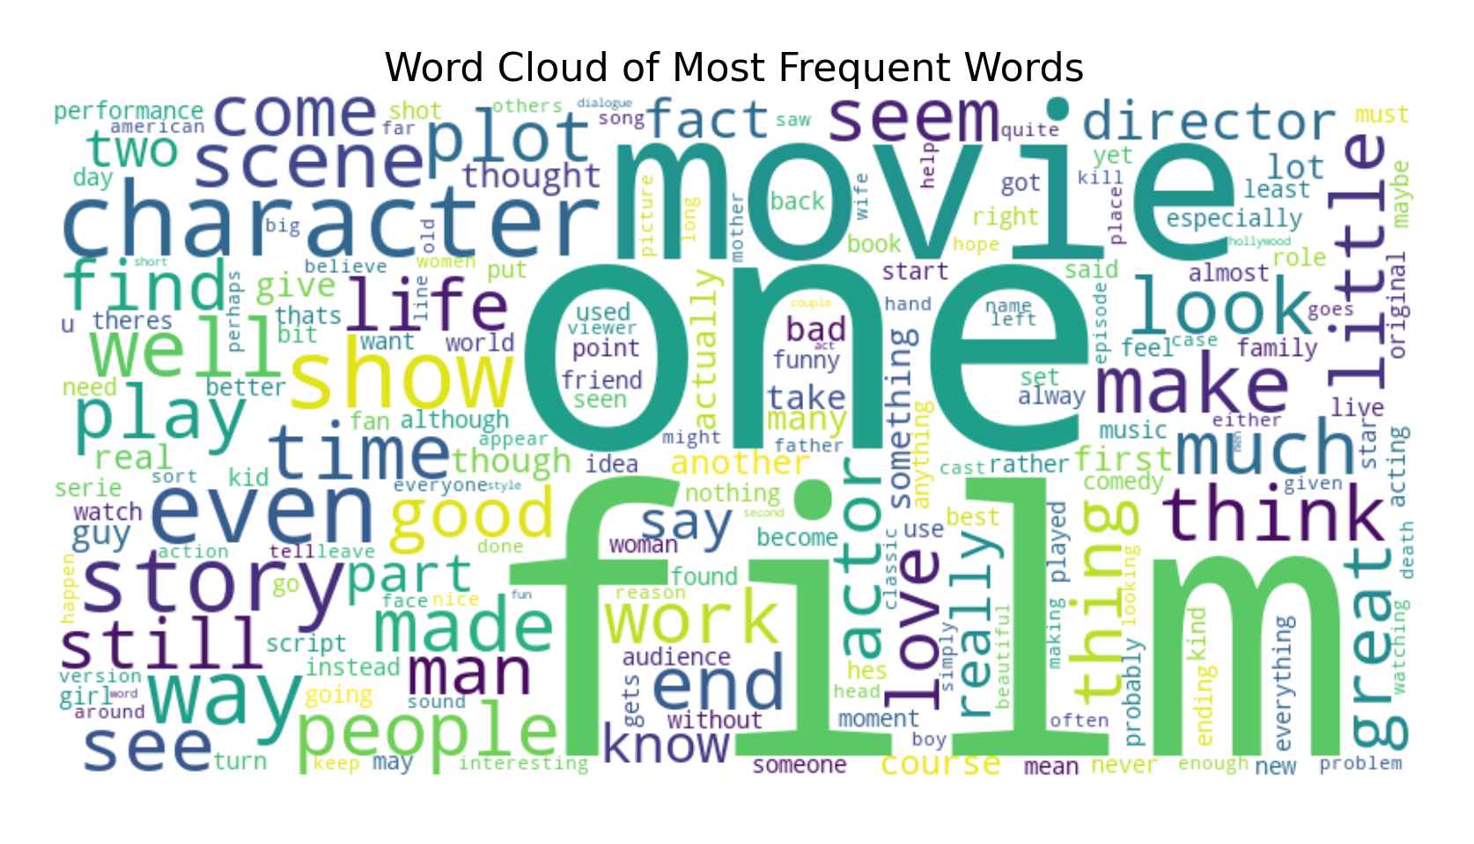
WORD CLOUD BEFORE and AFTER PRE-PROCESSING
BEFORE PRE-PROCESSING AFTER PRE-PROCESSING

Slide 9
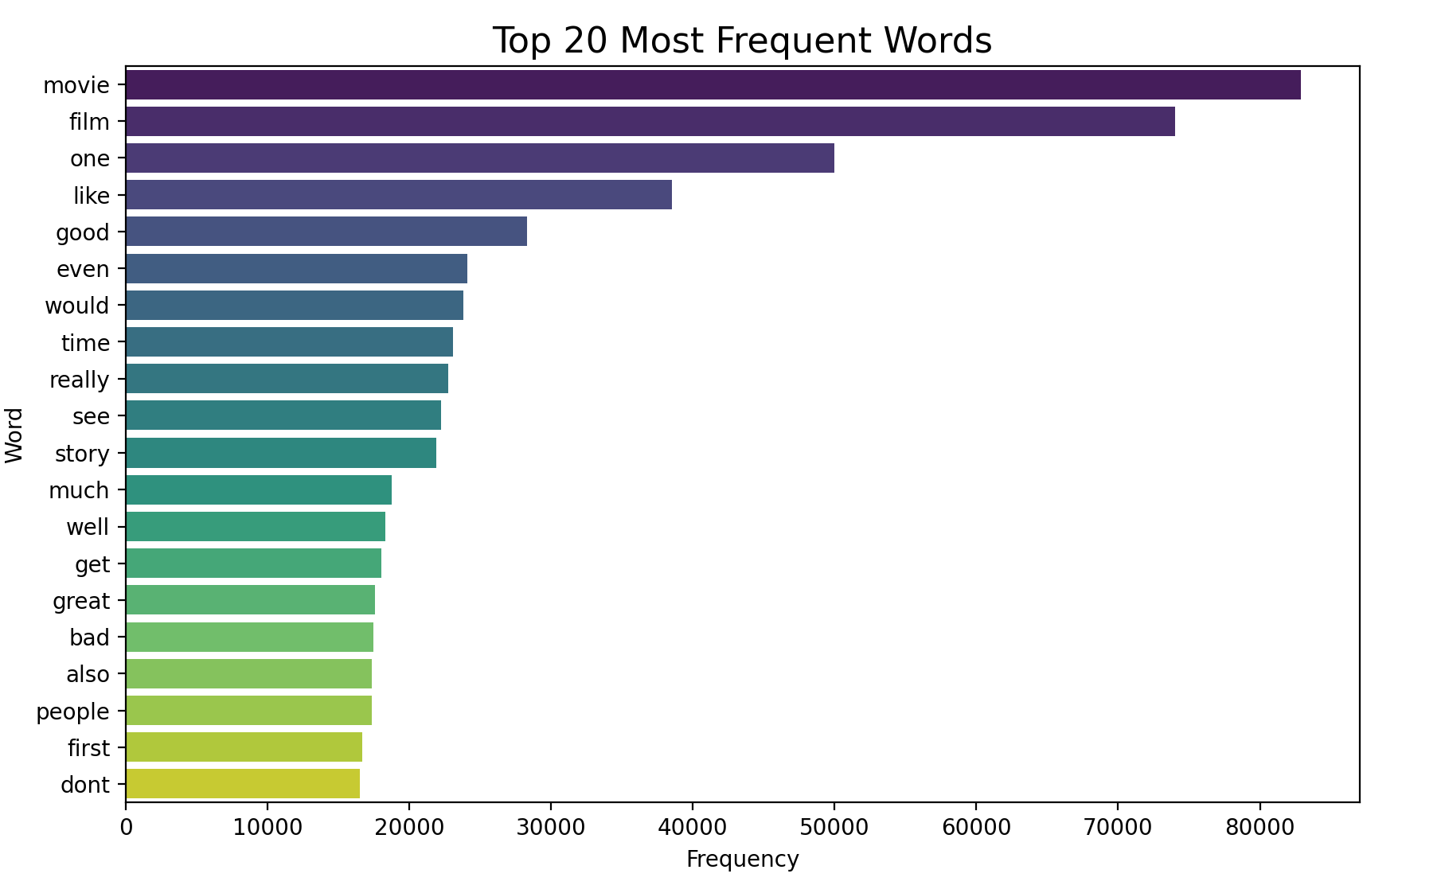
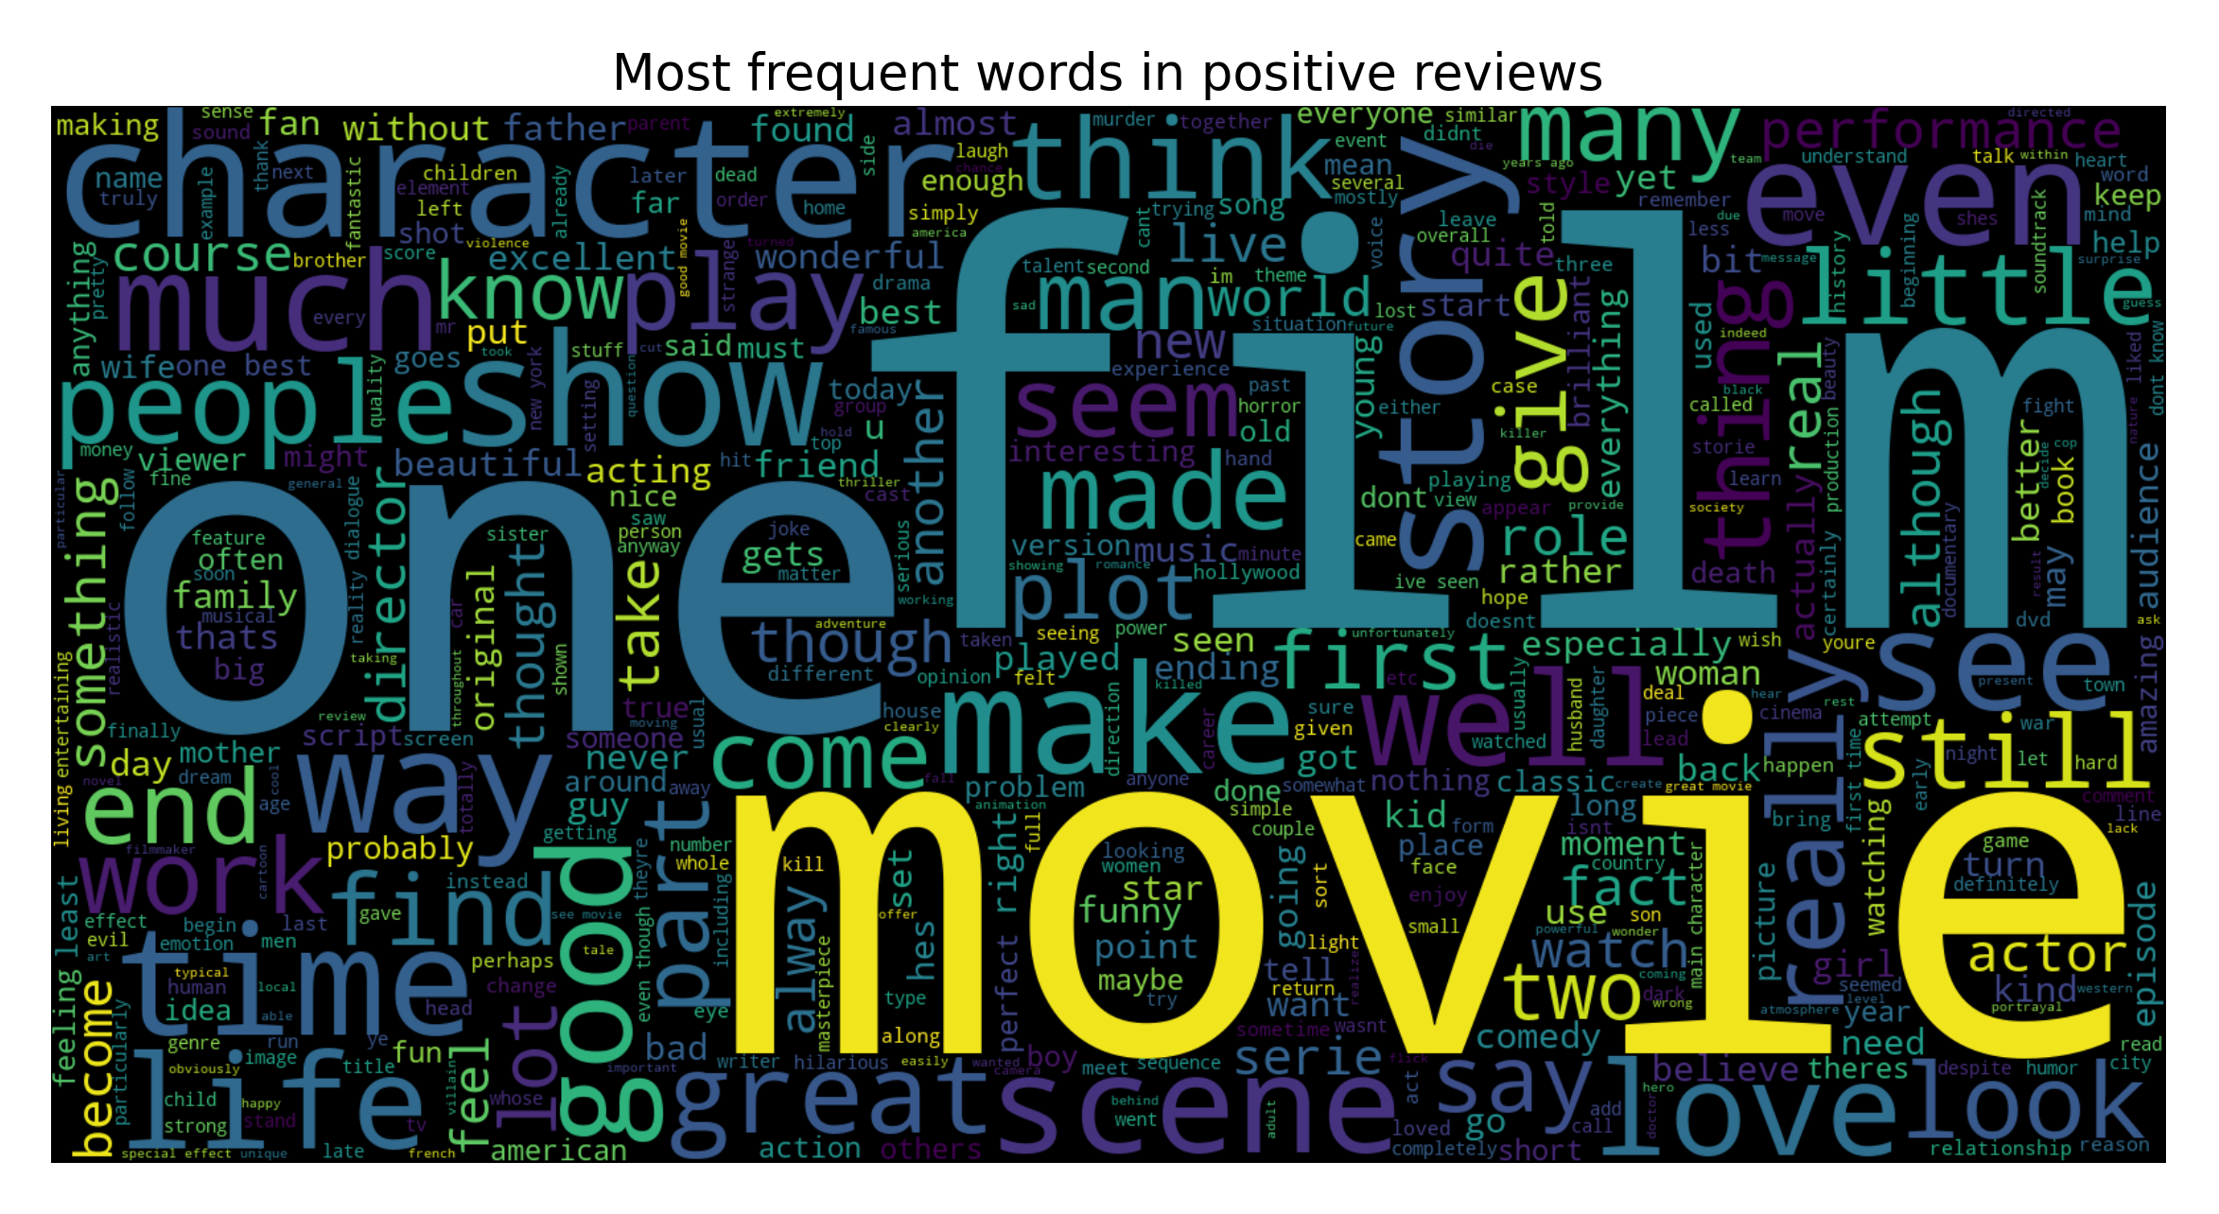
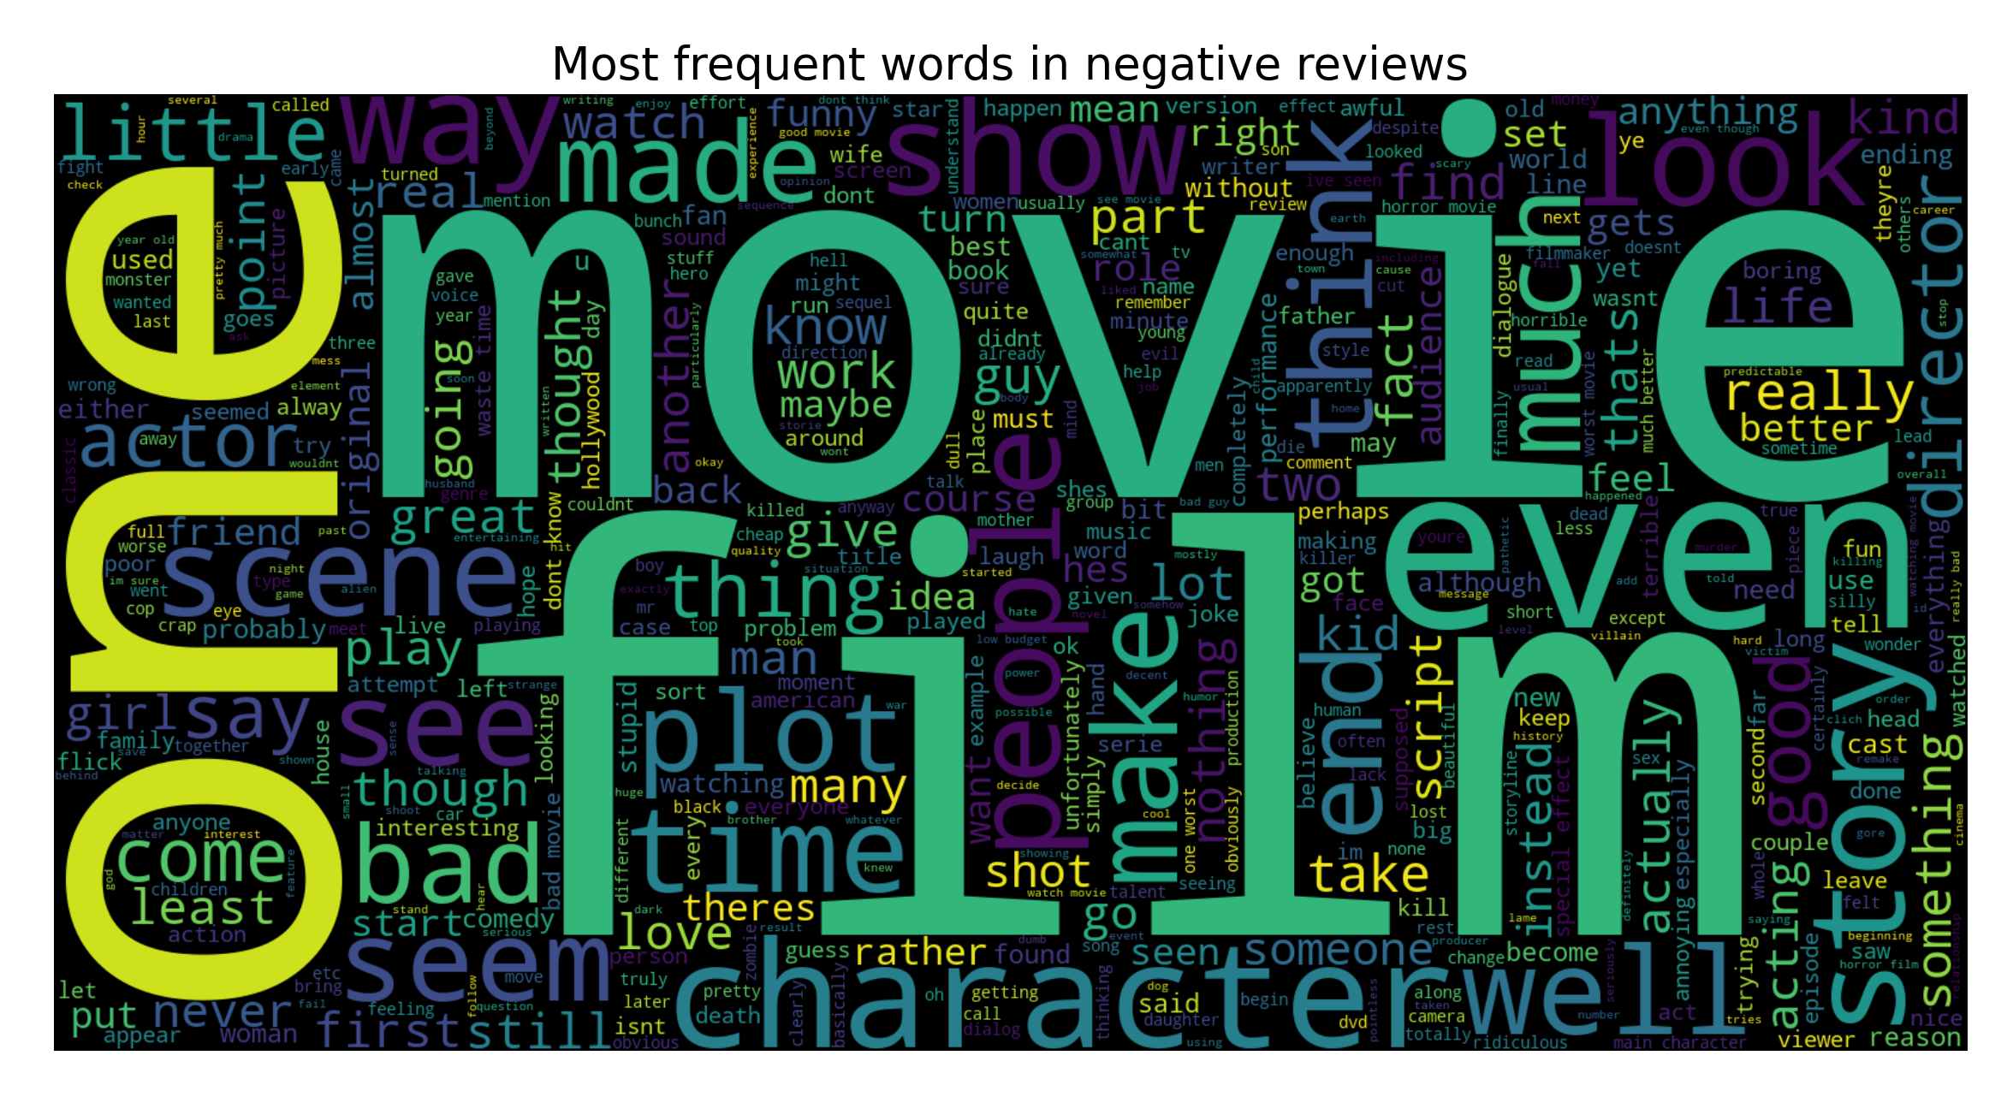
IMPORTANCE OF Data PREPROCESSING
EDA Foundation: Word Cloud and Frequent Word Analysis are essential for understanding data before modelling.
Model Improvement: Helps refine preprocessing steps (e.g., stop word removal, html tags removal, special characters removal, stemming).
Interpretability: Makes insights more accessible and actionable

Slide 10
Main Libraries Used:
Pandas (pd): For data loading, cleaning, and manipulation.
NumPy (np): To handle numerical computations efficiently.
NLTK (Natural Language Toolkit): To preprocess text: remove stop words, apply stemming, and tokenize.
Scikit-Learn (sklearn):
Feature Extraction:
Count Vectorizer: Converts text into numerical feature vectors using BoW.
Model Training and Evaluation:
Includes classifiers like Logistic Regression, Multinomial NB, Linear SVC, and Random Forest Classifier.
Metrics: Accuracy, Precision, Recall, F1-score (accuracy_score, etc.).
Matplotlib & Seaborn: To create visualizations like word clouds and bar plots.
Word Cloud: Generates word cloud visualizations to highlight the most frequent words in positive and negative reviews.
Joblib: Saves and loads trained models and vectorizers efficiently.

Slide 11
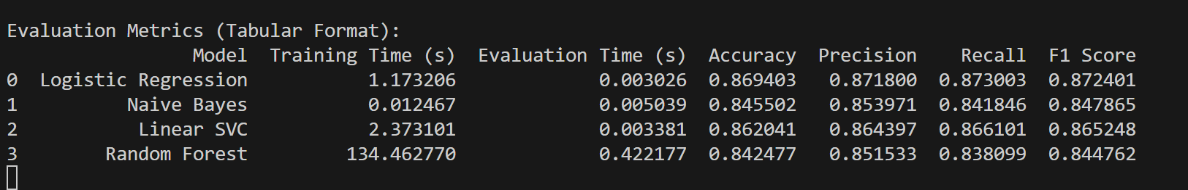
MODELS AND EVALUATION
The Models we have trained for evaluation are as follows:
Logistic Regression.
Naive Bayes.
Linear Support Vector Machine.
Random Forest.

Slide 12
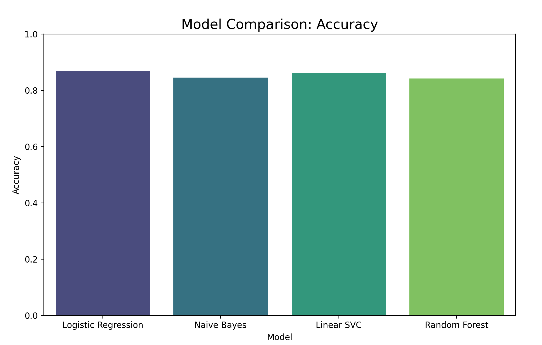
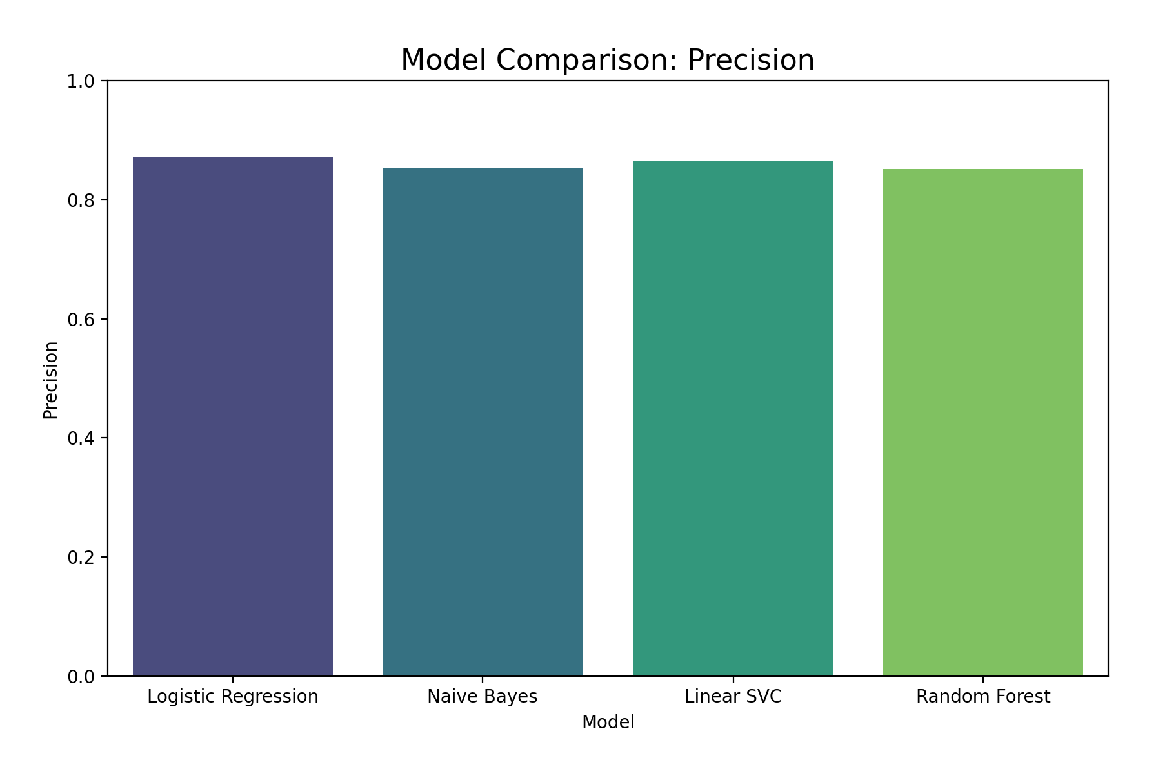
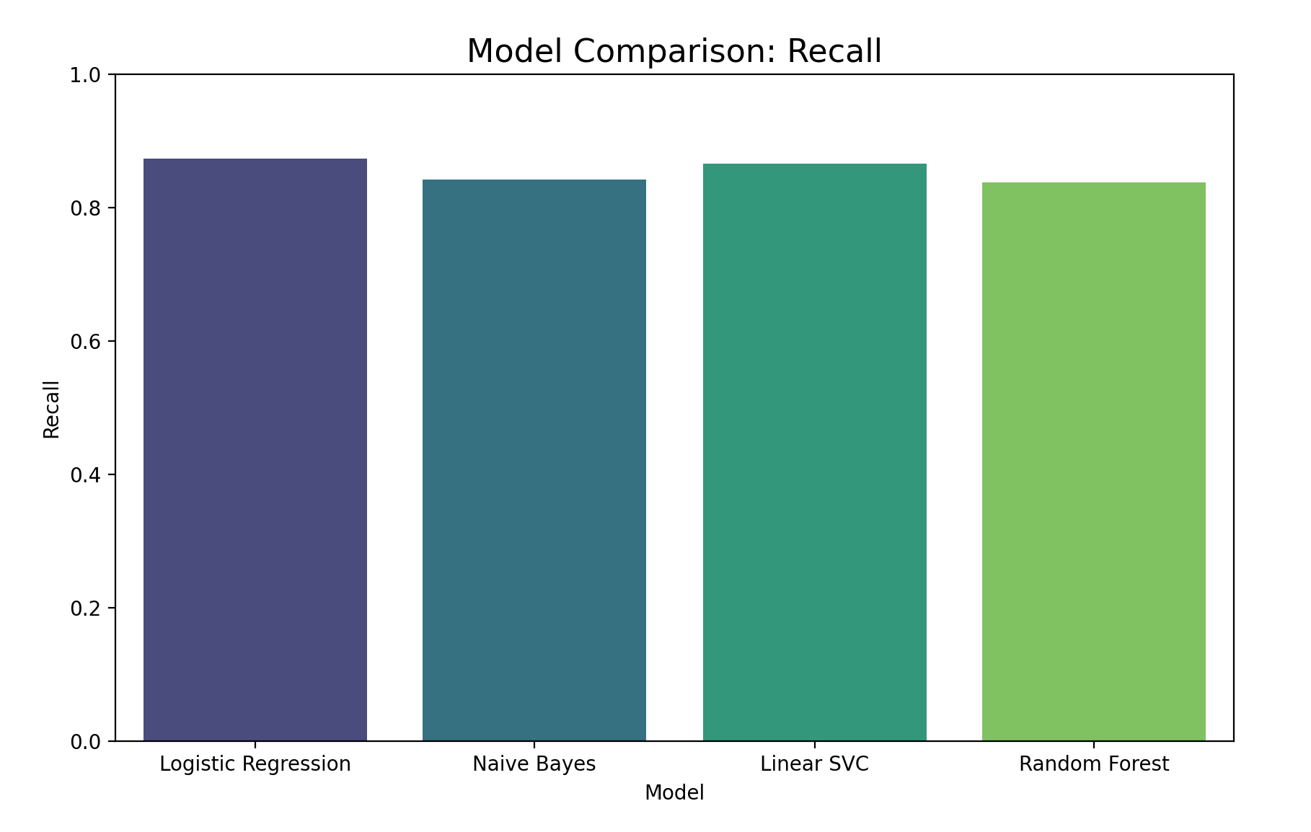
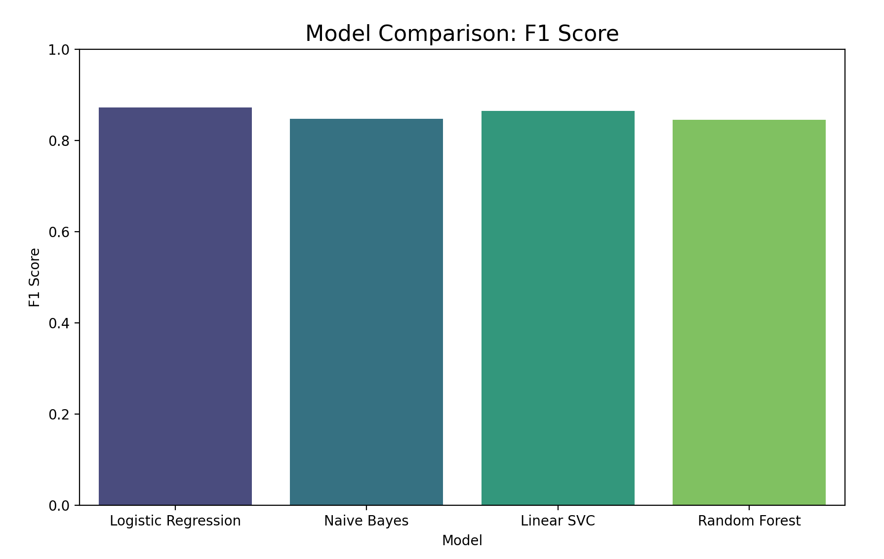
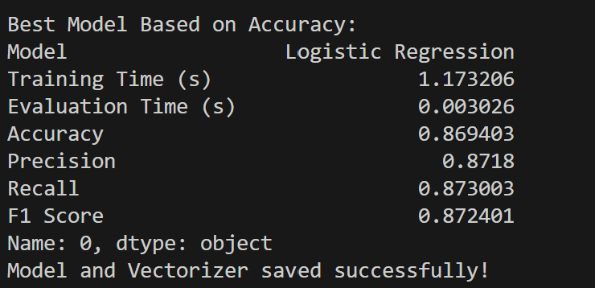
RESULTS AND ANALYSIS

Slide 13
CONCLUSION Based on the Evaluation Metrics:
Best Model for Accuracy and F1 Score:
Logistic Regression achieves the highest F1 Score (0.8724) and Accuracy (0.8694), making it the best-performing model in terms of balanced performance.
Fastest Training Model:
Naive Bayes has the fastest training time (0.012 seconds), making it ideal for scenarios where speed is a priority.
Most Time-Consuming Model:
Random Forest takes the longest time to train (134.46 seconds), which is significantly slower than other models.
Close Competition:
Linear SVC has comparable accuracy (0.8620) and F1 score (0.8652) to Logistic Regression but takes longer to train (2.37 seconds)
Trade-offs:
While Random Forest is robust, it is computationally expensive and doesn't outperform Logistic Regression or Linear SVC in terms of accuracy or F1 score.

Slide 14
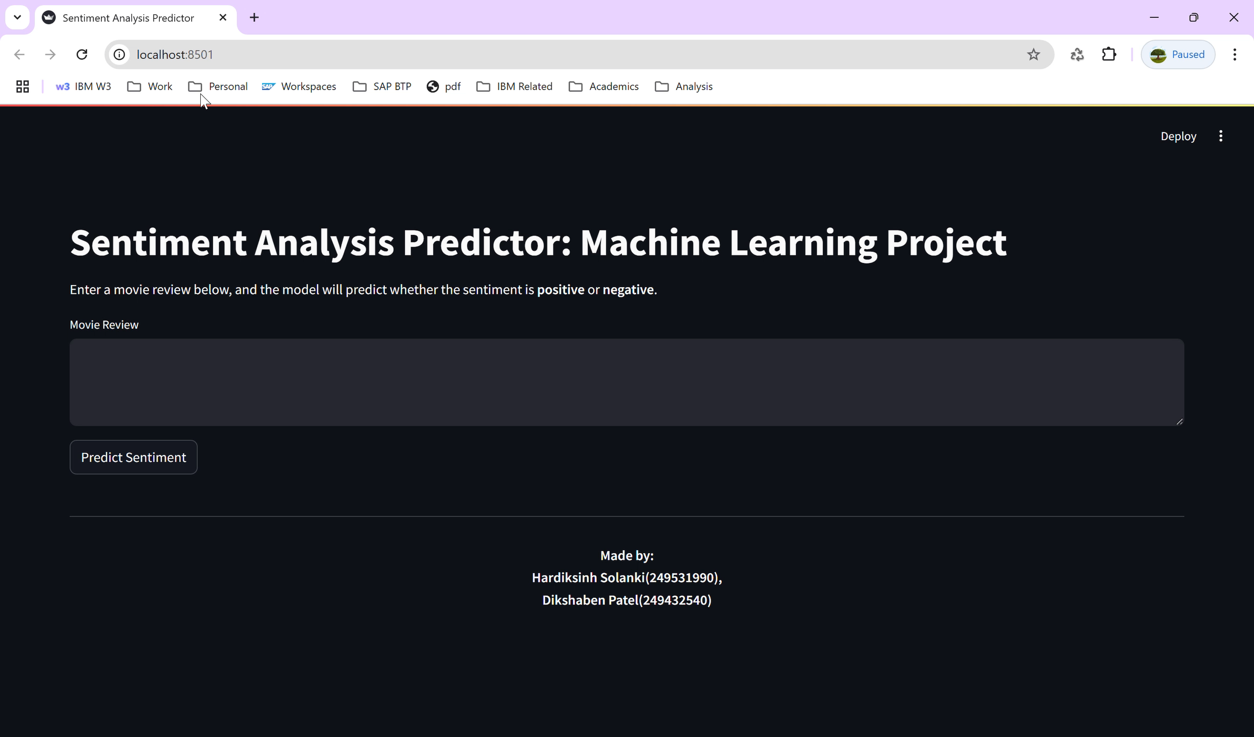
A SHORT DEMO

Slide 15


